Slide 1

Implementing a shear-transformation-zone model in MPM and SPFEM using MFront
W.L. Li¹, N. Guo¹, Z.X. Yang¹, T. Helfer²
¹ Zhejiang University
² CEA
25 November 2020

Slide 2


Where are we?
ZJU is located in Hangzhou.
Historical city that blends the classic and modern elements of China
Famous for sightseeing and e-commerce
Host of the 2022 Asian Games

Slide 3
Outline
Shear-transformation-zone (STZ) model
MFront implementation and MTest
Interfacing NairnMPM via MFrontGenericInterfaceSupport
Applications
Granular column collapse, footing settling on soft ground
Interfacing SPFEM in Python via mgis.behaviour
Discussion

Slide 4
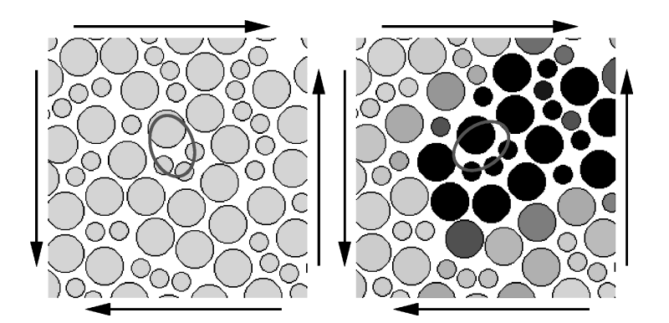
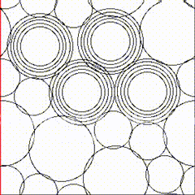
Model introduction
Basic idea of STZ theory
Closeup of shear transformation zone before
and after undergoing transformation
Simulation of a bubble model in 2D
undergoing oscillatory shear strain
(Falk and Langer, 1998)
(Lundberg et al., 2007)
The STZ theory attributes plastic deformation to irreversible, local granular rearrangements occurring at loose spots, known as STZs.

Slide 5
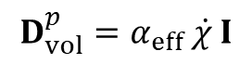
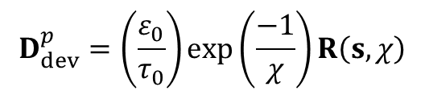
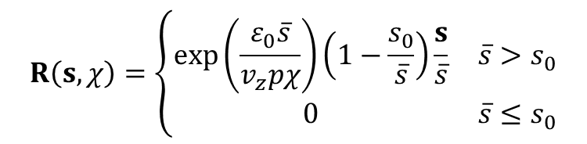
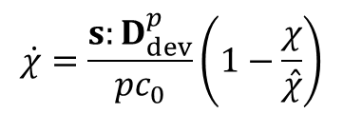
Formulation
A non-equilibrium thermodynamics framework
State parameter: compactivity
Plastic strain rate:
$$\begin{aligned}&D_{dev}^{p}=\left(\frac{ε_{0}}{τ_{0}}\right)exp\left(\frac{−1}{χ}\right)R\left(s,χ\right)\end{aligned}$$
Evolution:
$$\begin{aligned}&\dot{χ}=\frac{s:D_{dev}^{p}}{pc_{0}}\left(1−\frac{χ}{\hat{χ}}\right)\end{aligned}$$
$$\begin{aligned}&D_{vol}^{p}=α_{eff} \dot{χ} I\end{aligned}$$
STZ flipping rate:
$$R\left(s,χ\right)=\left\{\begin{matrix}exp\left(\frac{ε_{0}\overline{s}}{v_{z}pχ}\right)\left(1−\frac{s_{0}}{\overline{s}}\right)\frac{s}{\overline{s}} & \overline{s}>s_{0} \\ 0 & \overline{s}≤s_{0}\end{matrix}\right.$$
(Ma and Elbanna, 2018)

Slide 6
Implementation

Slide 7
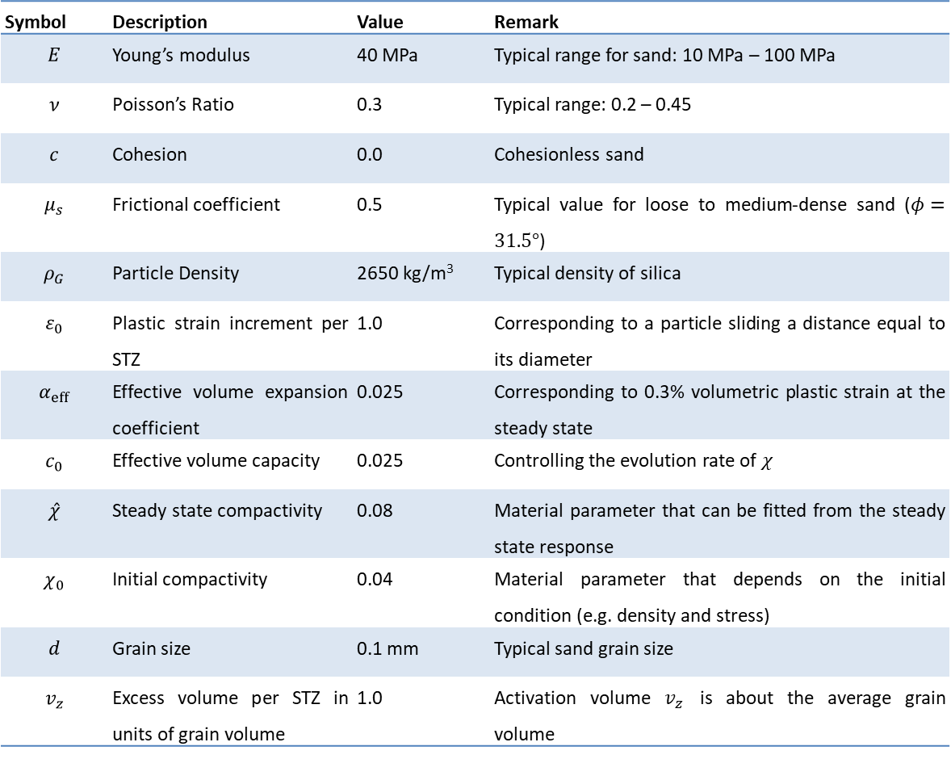
Model parameters
Symbol | Description | Value | Remark
$$E$$ | Young’s modulus | 40 MPa | Typical range for sand: 10 MPa – 100 MPa
$$ν$$ | Poisson’s Ratio | 0.3 | Typical range: 0.2 – 0.45
$$c$$ | Cohesion | 0.0 | Cohesionless sand
$$μ_{s}$$ | Frictional coefficient | 0.5 | Typical value for loose to medium-dense sand ($φ=31.5°$)
$$ρ_{G}$$ | Particle Density | 2650 kg/m³ | Typical density of silica
$$ε_{0}$$ | Plastic strain increment per STZ | 1.0 | Corresponding to a particle sliding a distance equal to its diameter
$$α_{eff}$$ | Effective volume expansion coefficient | 0.025 | Corresponding to 0.3% volumetric plastic strain at the steady state
$$c_{0}$$ | Effective volume capacity | 0.025 | Controlling the evolution rate of $χ$
$$\hat{χ}$$ | Steady state compactivity | 0.08 | Material parameter that can be fitted from the steady state response
$$χ_{0}$$ | Initial compactivity | 0.04 | Material parameter that depends on the initial condition (e.g. density and stress)
$$d$$ | Grain size | 0.1 mm | Typical sand grain size
$$v_{z}$$ | Excess volume per STZ in units of grain volume | 1.0 | Activation volume $v_{z}$ is about the average grain volume

Slide 8
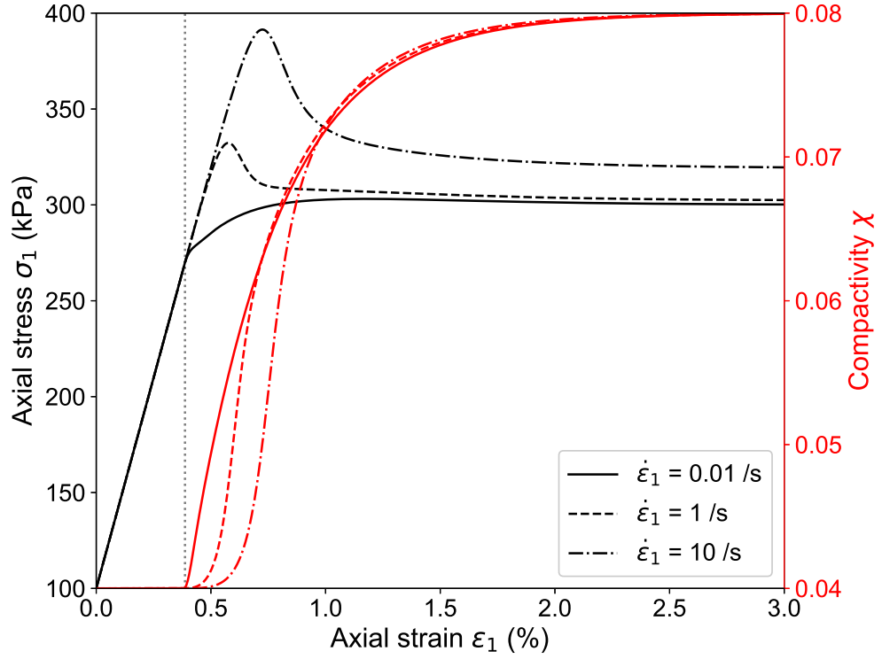
Model performance
Biaxial shear tests subjected to different strain rates

Slide 9
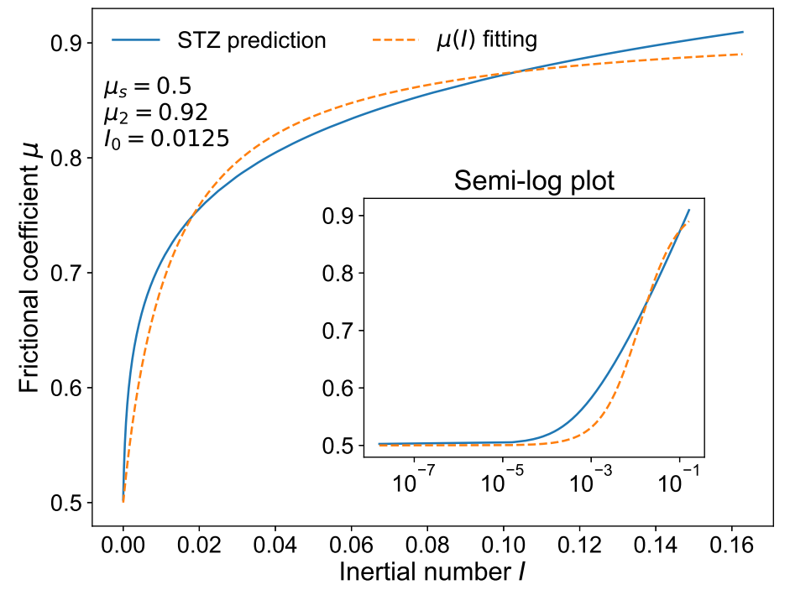
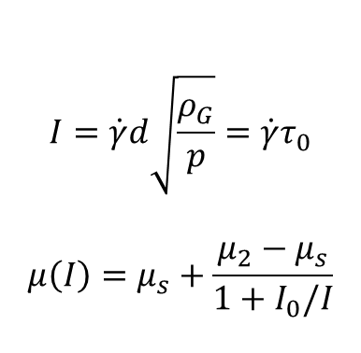
Model performance
$$\begin{aligned}\begin{aligned}I=\dot{γ}d\sqrt{\frac{ρ_{G}}{p}}\end{aligned}=\dot{γ}τ_{0}\#\end{aligned}$$
$$\begin{aligned}μ\left(I\right)=μ_{s}+\frac{μ_{2}−μ_{s}}{1+I_{0}/I}\#\end{aligned}$$
Compared with $μ(I)$ model

Slide 10
Interfacing NairnMPM
NairnMPM
NairnMPM is an open-source platform for the material point method (MPM) simulations written in object-oriented C++. The code is developed and maintained by Prof. J.A. Nairn at the Oregon State University. Parallel computation is achieved in the code.
(Tan and Nairn, 2002)
MfrontGenericInterfaceSupport (MGIS)
MGIS is an MFront project developed to provide bindings to other programming languages for the constitutive models implemented by MFront. The available bindings available currently include Python, Julia, Fortran 2003 and C/C++.
(Helfer et al., 2020)

Slide 11
Interfacing NairnMPM
Computational cycle for one timestep in MPM
Map from material points to nodes
Compute nodal mass
Compute nodal momentum
Compute nodal velocity
P2G
Update deformation and stress of material points
Compute material point strain increment
Update material point strain
Transfer strain increment and state variable to MGIS
Update stress and state variable information using MGIS
Transfer updated stress and state variable back to NairnMPM
Map from nodes to material points
Update particle velocity
Update particle position
G2P
Solve momentum equation
Compute internal force ad external force
Compute total nodal force
Update nodal momentum

Slide 12

Interfacing NairnMPM
Coupling NairnMPM and MGIS
NairnMPM
MGIS
Set material property and initialize
state information of STZ model
Using MGISBehaviourHandler to
load Behaviour object b
Using BehaviourData d to store state
information of an integration point
Loop over all material points
Recover the state information
of a material point at last step
MGIS engine
Using Integrate to update state
information for given strain increment
Retrieve updated state information from
BehaviourData and transfer back to NairnMPM

Slide 13
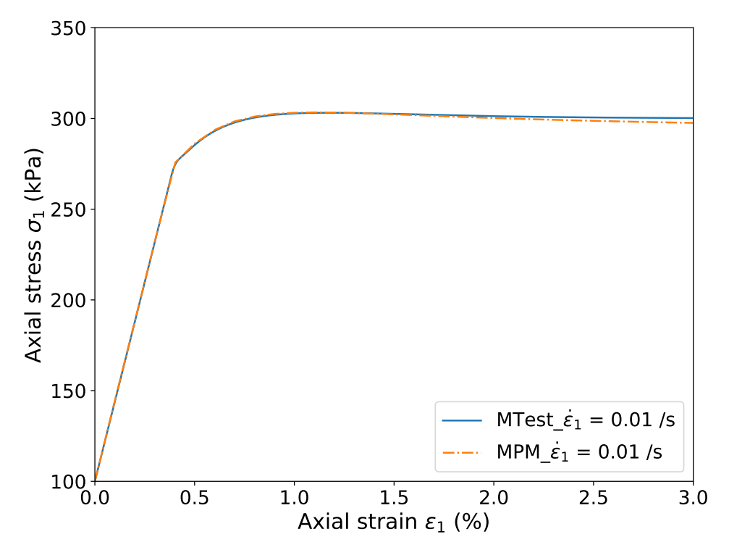
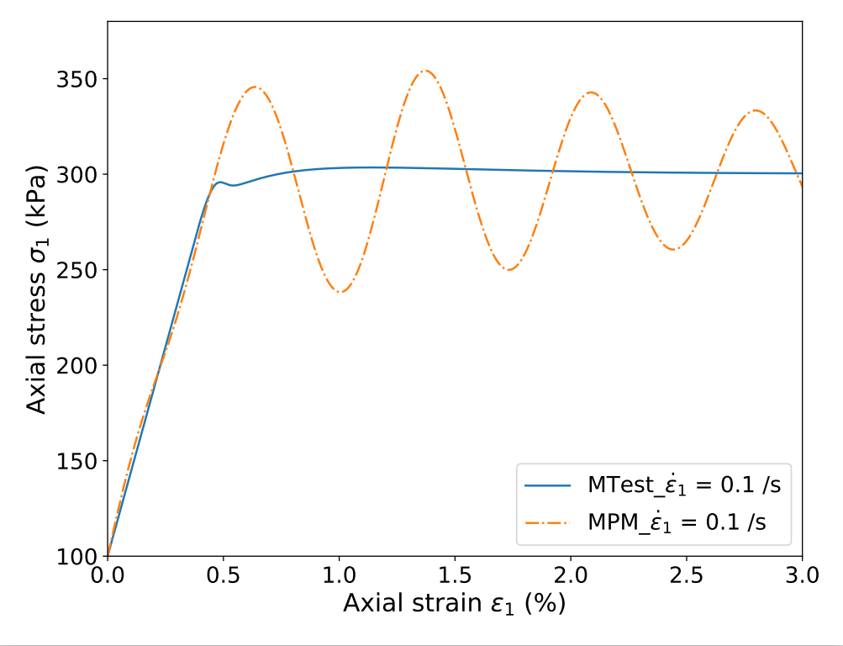
Interfacing NairnMPM
Verification of the coupling
Biaxial shear tests subjected to different strain rates

Slide 14
Application
Granular column collapse
Geometric and material parameters following Nguyen et al. (2017)

Slide 15
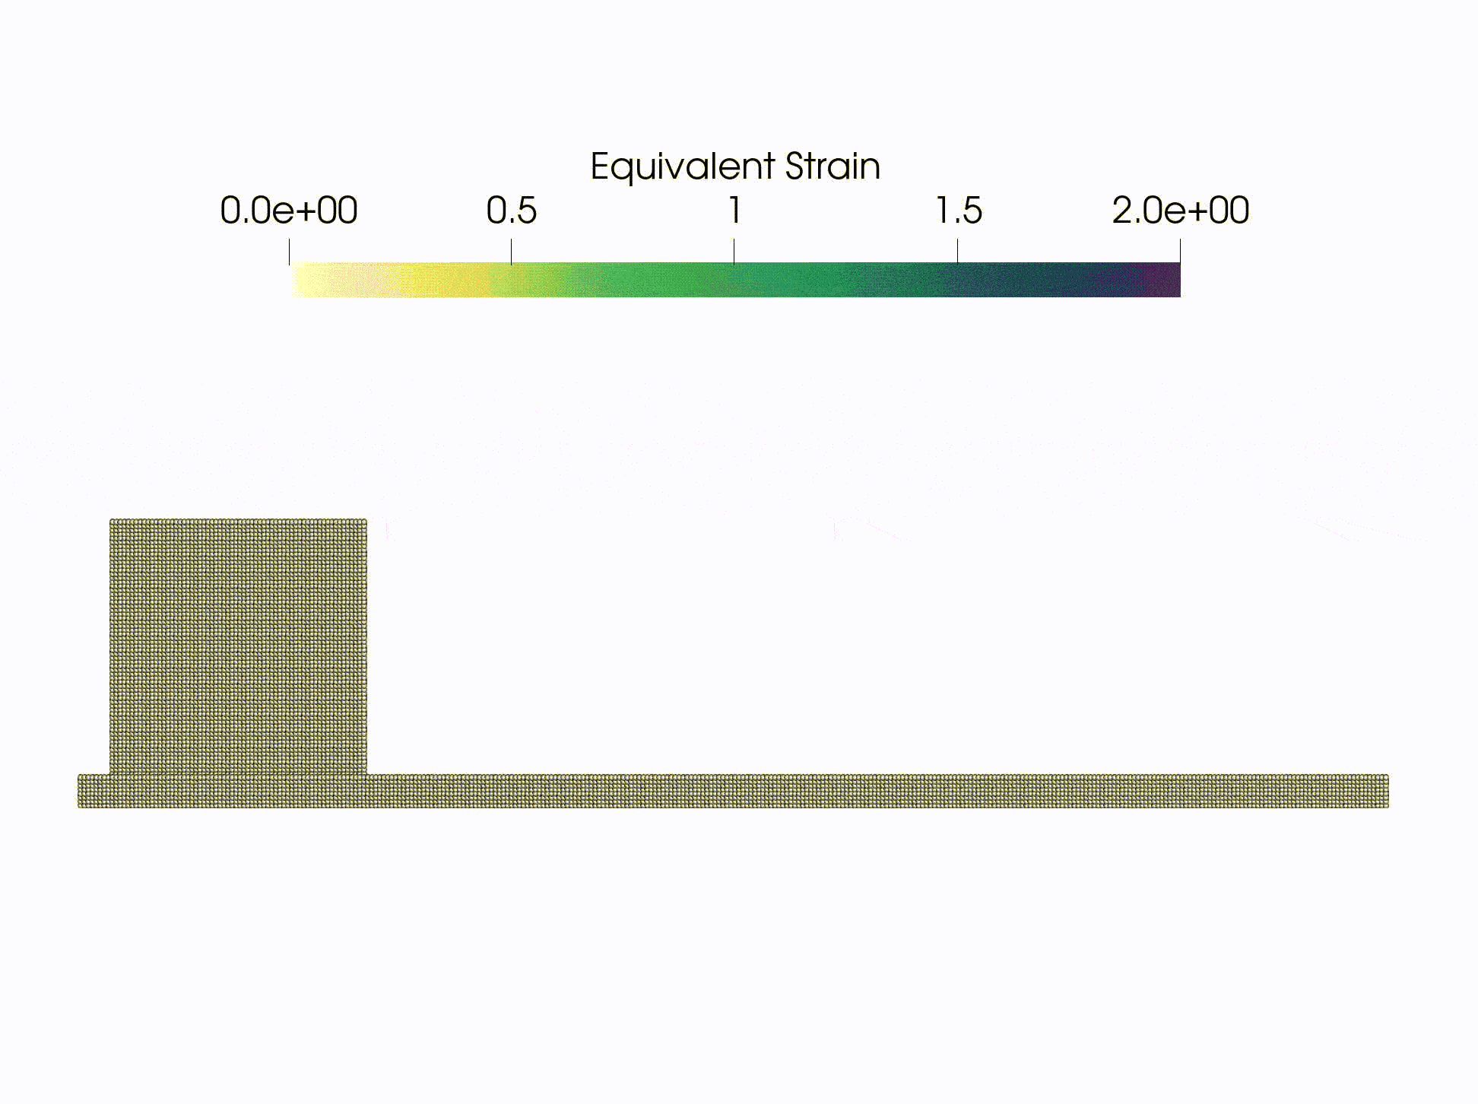
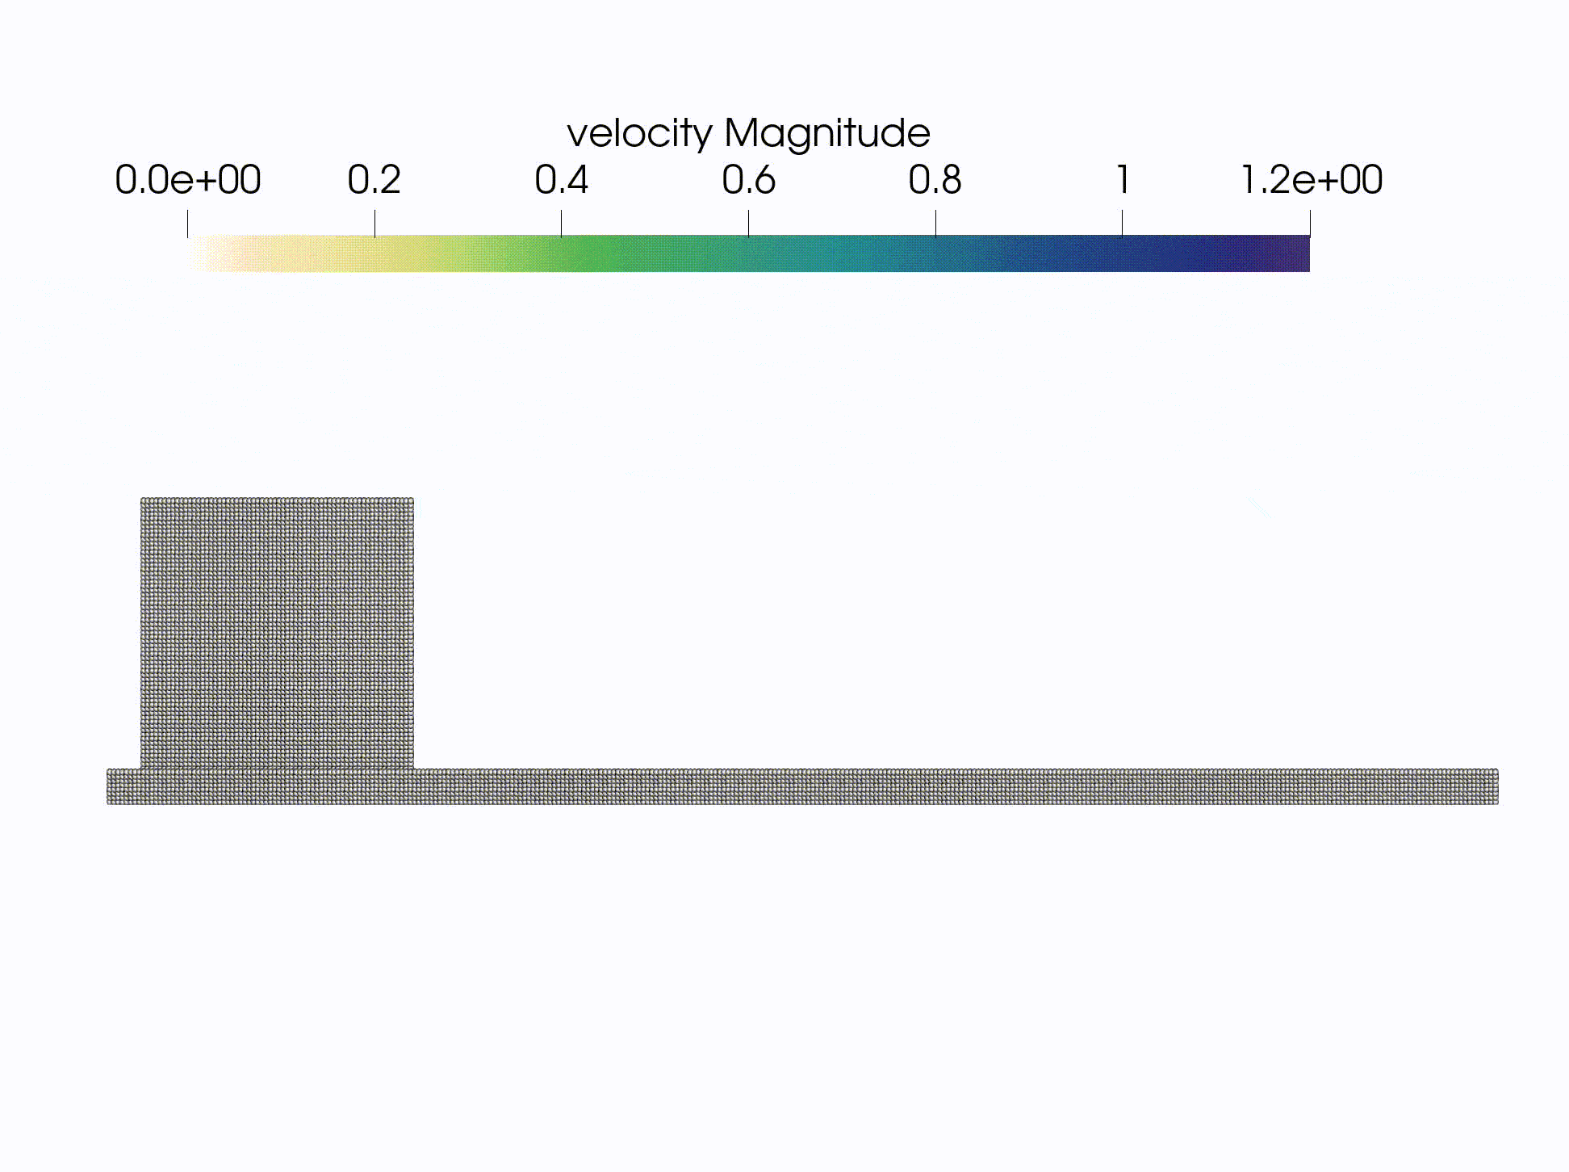
Application
Flow animation

Slide 16
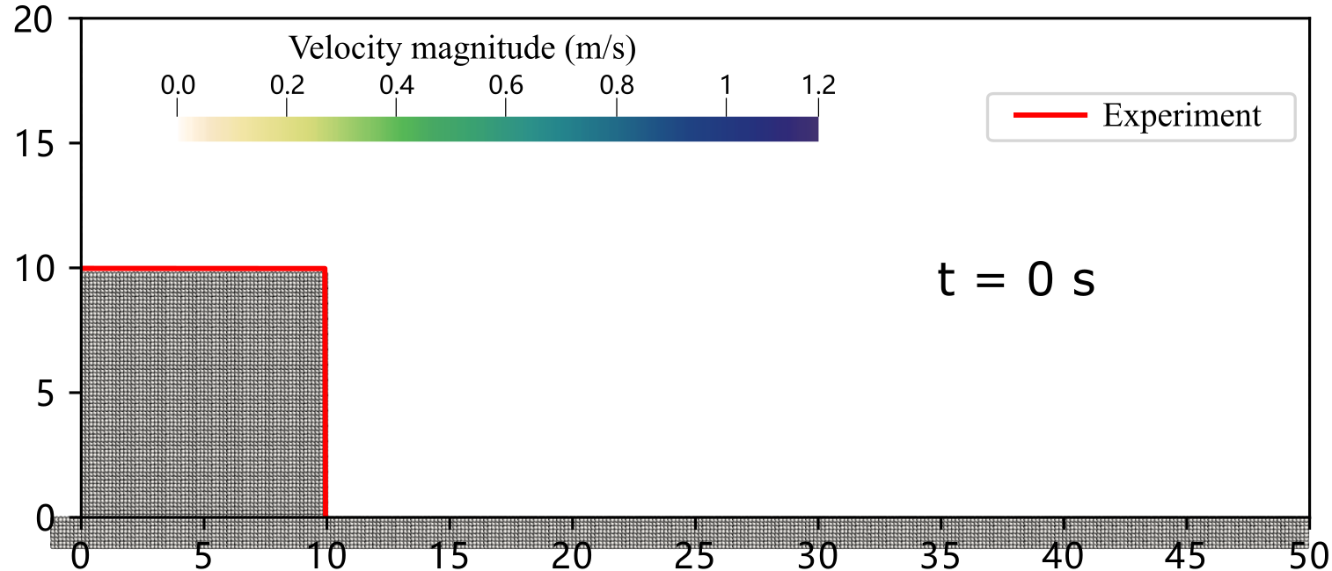
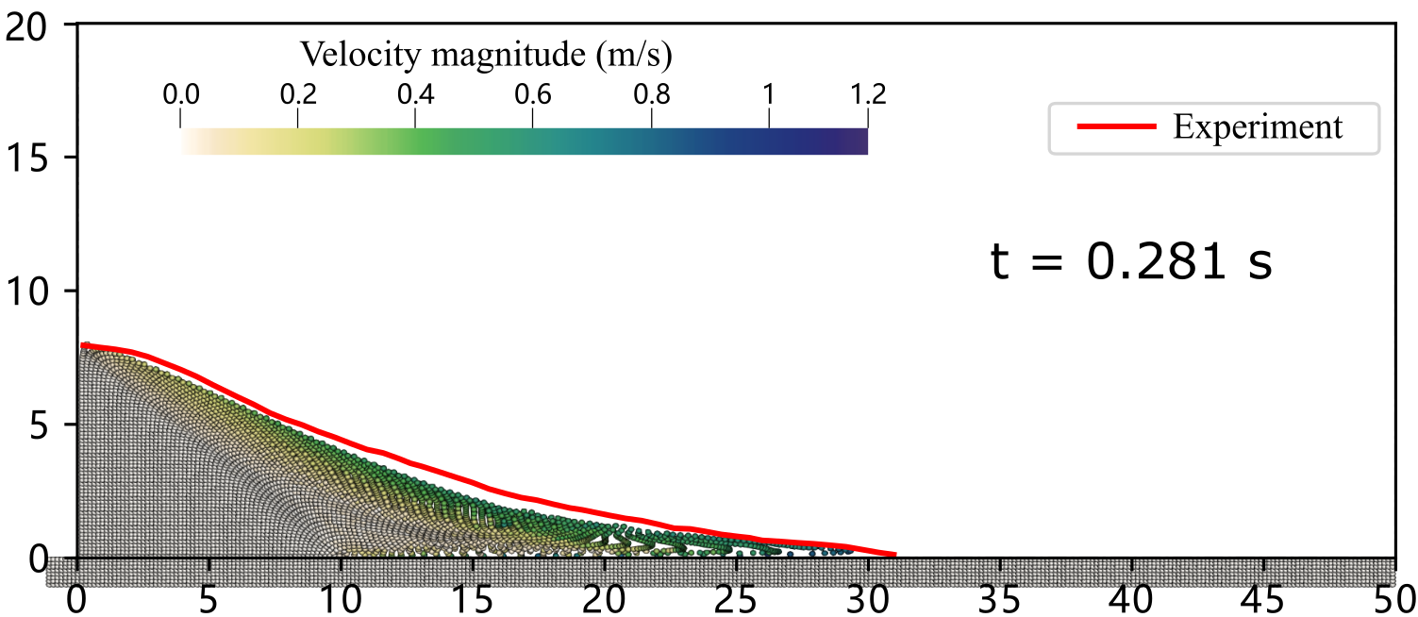
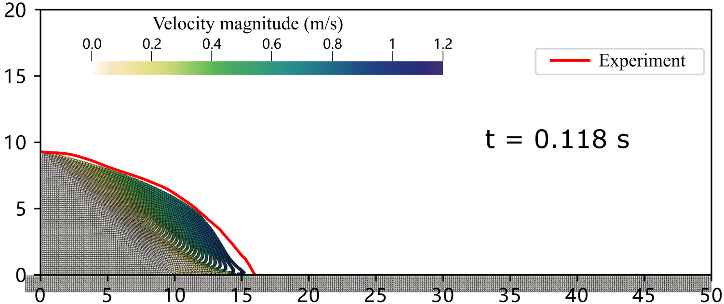
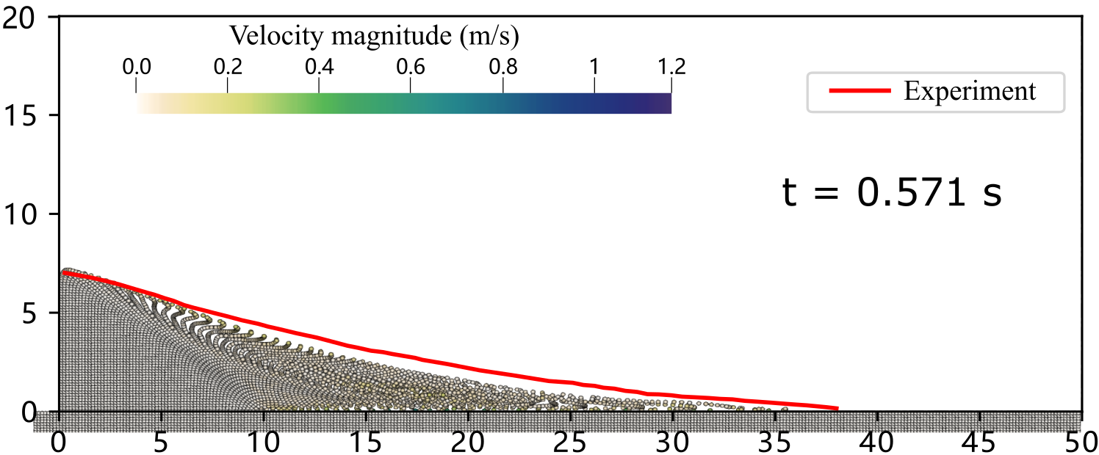
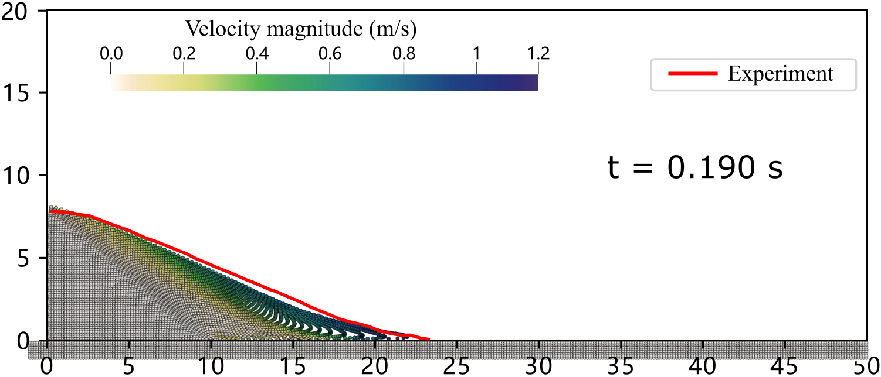
Application
Compared with experiment

Slide 17
Application
Footing settling on soft ground

Slide 18
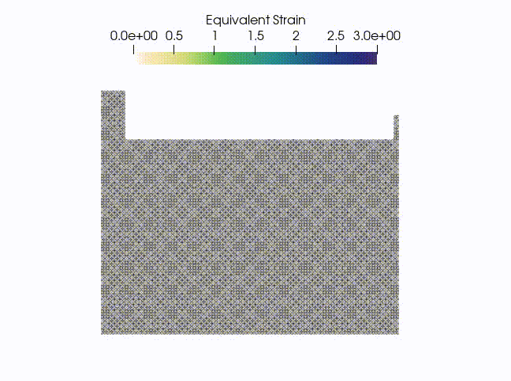
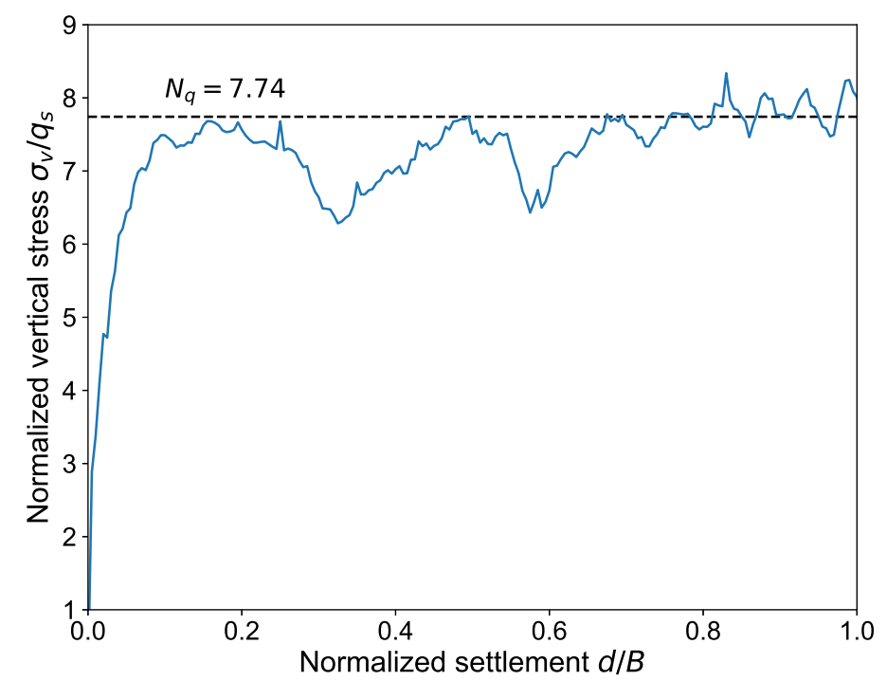
Application
Animation and load-settlement curve

Slide 19
Interfacing SPFEM in Python

Slide 20
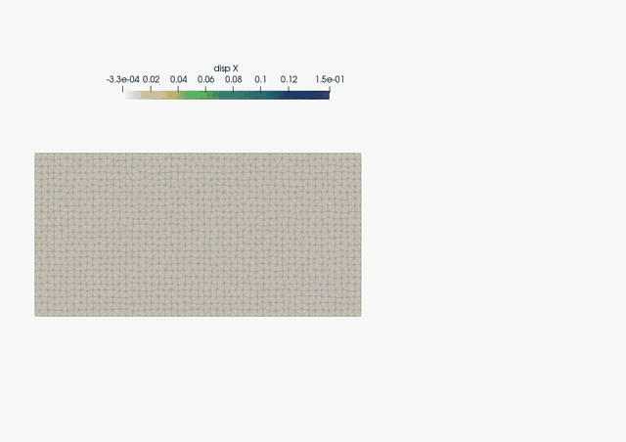
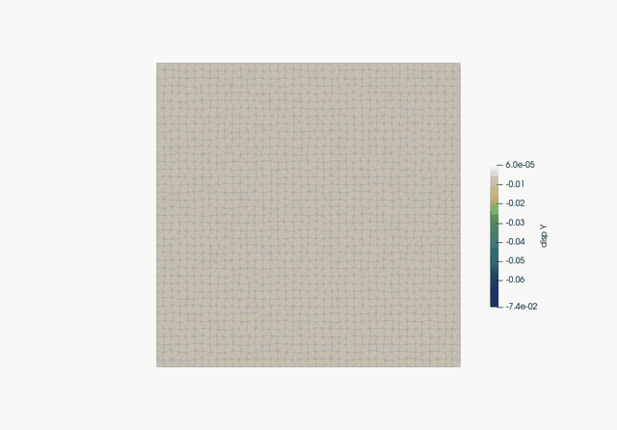
Interfacing SPFEM in Python
Application animations
Granular column collapse
Granular silo discharge

Slide 21
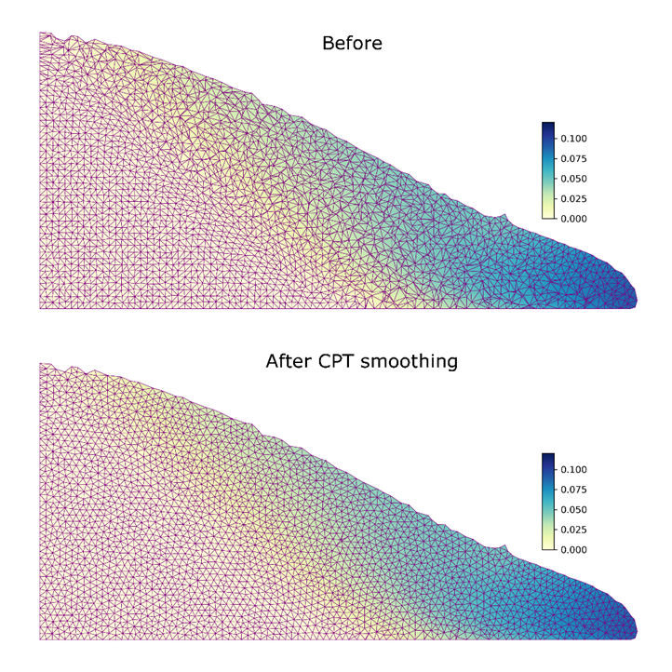
Discussion
Parallel computing
Multiple materials
Adding/removing data points
Mesh interpolation

Slide 22
Thank you!

